Slide 1
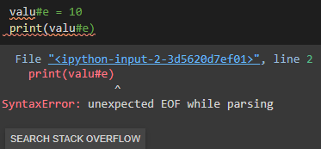
Compiler
Lexical – Syntax – Semantic analyzer
Lexical analyzer:
EX1 > Report that a number 18..23 is not a legal number.
EX2 > Report val#ue variable names cannot have „#‟ character.

Slide 2
Compiler
Lexical – Syntax – Semantic analyzer
Semantic analyzer:
Scope - Type checking
EX1 > if(int x =0, int y=0.5) #use x out of if (scope)
EX2 > Identifier x has type Boolean in the statement x=17; (type checking)

Slide 3
Compiler
Lexical – Syntax – Semantic analyzer
Syntax analyzer:
EX1 > Operator =< is not a legal operator.
EX2 > Report that a closing „}‟ at the end of a method definition is missing.
EX3 >Assignment statement doesn‟t end with a semicolon ( ; ).
EX4 > Report in fi(x>y) that a fi is not a keyword.

